Slide 1
Domain Relational Calculus

Slide 2
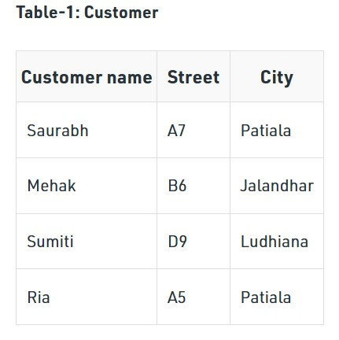
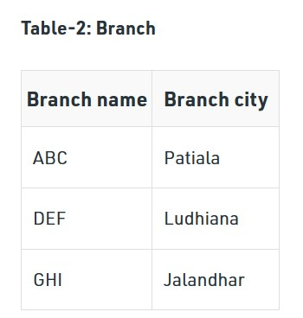
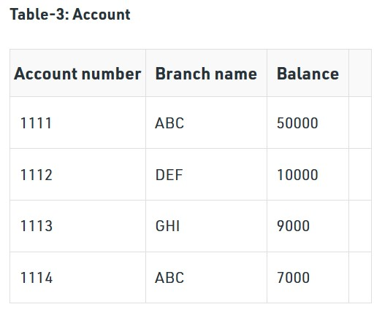
Example

Slide 3
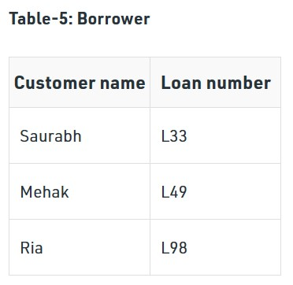
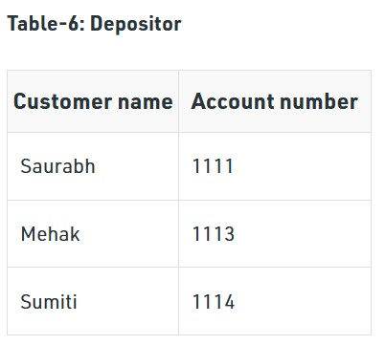
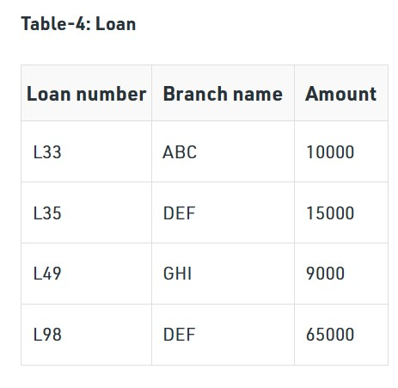

Slide 4
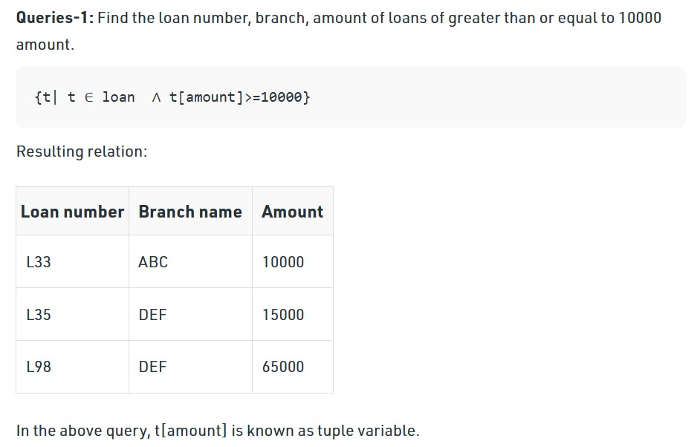

Slide 5
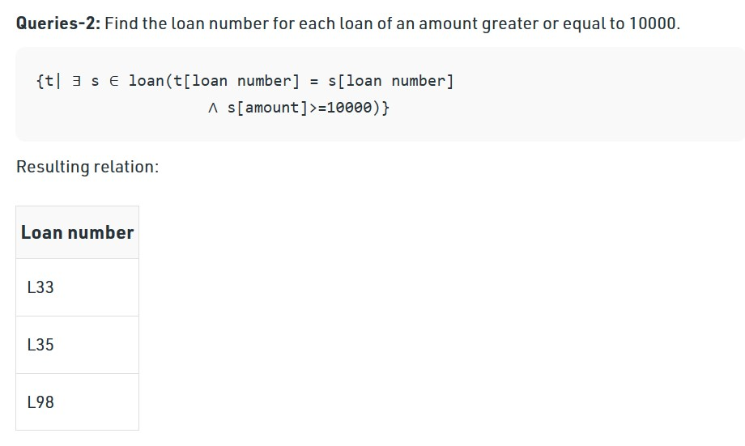

Slide 6
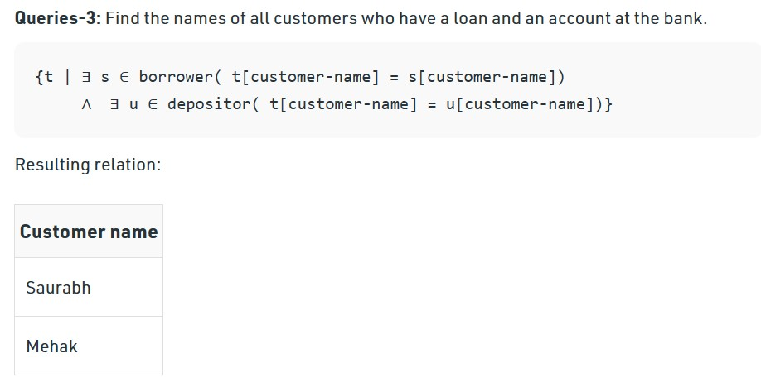

Slide 7
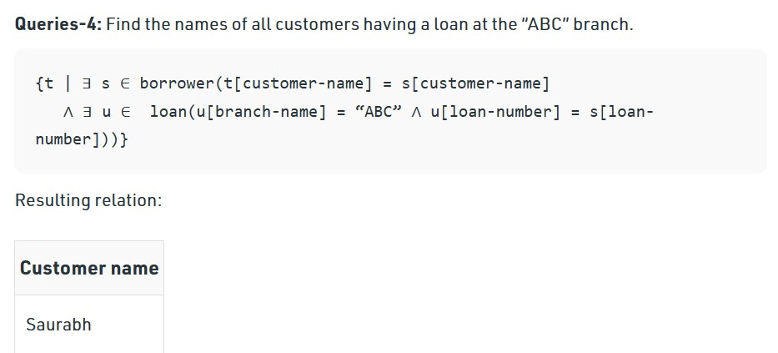

Slide 8
Domain Relational Calculus
Domain Relational Calculus is a non-procedural query language equivalent in power to Tuple Relational Calculus.
Domain Relational Calculus provides only the description of the query but it does not provide the methods to solve it.
In Domain Relational Calculus, a query is expressed as,
{ < x₁, x₂, x₃, ..., x_{n} > | P (x₁, x₂, x₃, ..., x_{n} ) }
where, < x₁, x₂, x₃, …, x_{n} > represents resulting domains variables and P (x₁, x₂, x₃, …, x_{n} ) represents the condition or formula equivalent to the Predicate calculus.

Slide 9
Predicate Calculus Formula:
Set of all comparison operators
Set of connectives like and, or, not
Set of quantifiers

Slide 10
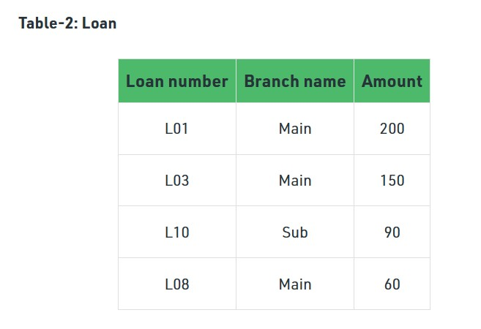
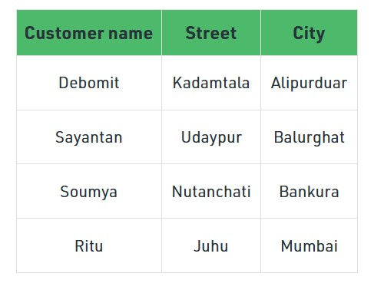
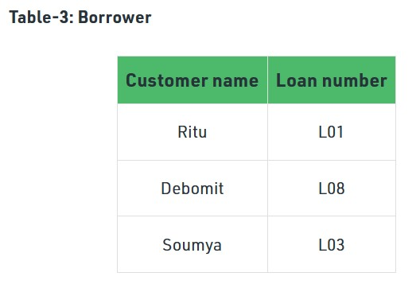
Example: Table-1: Customer

Slide 11
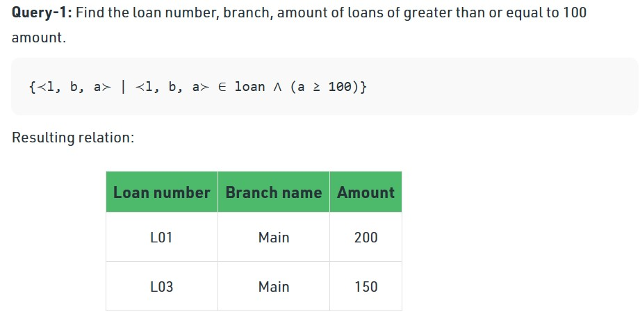

Slide 12
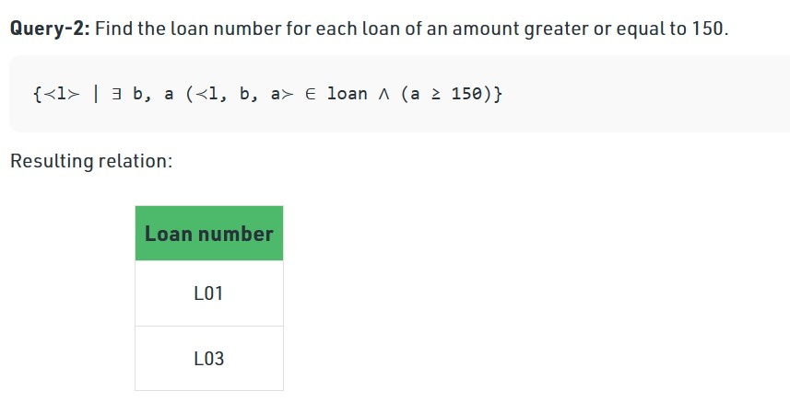

Slide 13
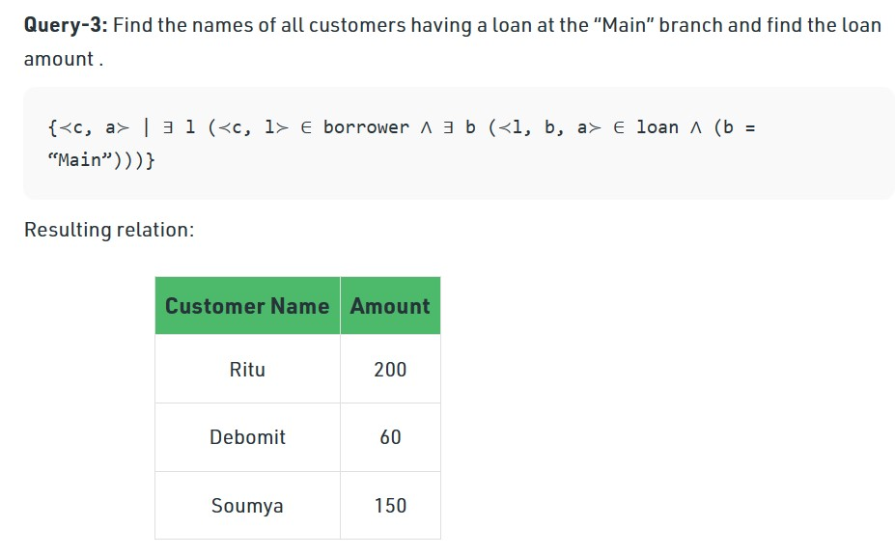

Slide 14
Expressive power of algebra and calculus
Codd's theorem states that relational algebra and the domain-independent relational calculus queries, two well-known foundational query languages for the relational model, are precisely equivalent in expressive power.
Safety - Certain queries stated in the relational calculus may lead to answers which contain an infinite number of tuples (or at least as many as the system can handle).
Example: Consider the TRC query {S ‌ ¬(S ∈ Sailors)}. Since there is a quasi-infinite number of tuples that can be created with the attributes of sailors, the answer is (quasi)-infinite. - A query which yields a (quasi)-infinite answer is said to be unsafe, and, of course, should not be allowed by the system. - It is possible to define a safe formula in TRC.

Slide 15
A query language is said to be relationally complete if it can express all the queries that can be expressed in relational algebra.
SQL is relationally complete.
Every query that can be expressed using a safe relational calculus query can be also be expressed as a relational algebra query.
SQL provides additional expressive power beyond relational algebra.

